Slide 1
RtES project PING PONG esploration on ros2 node
D’Amicis Ignazio – 2022/2023

Slide 2
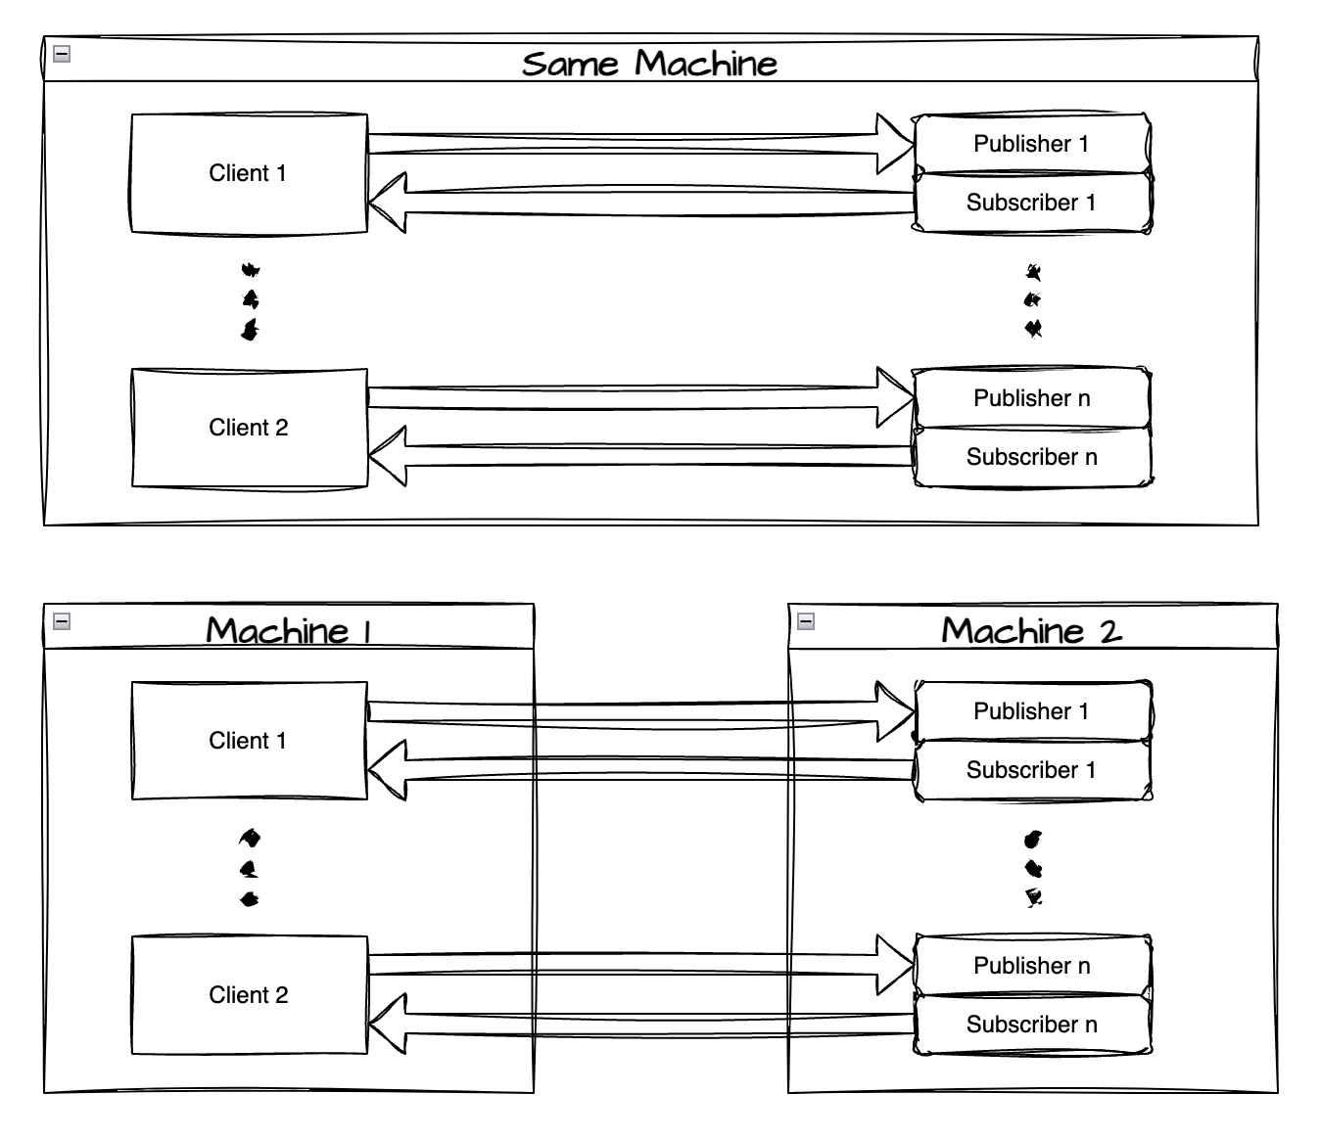
1- What is this project about?
The main goal of this project is to analyze the performace between ros node in two different scenario:
1) All the node run on the same Machine.
2) Node are split into differente machine.
N.B. → In this example we use only two machine.

Slide 3
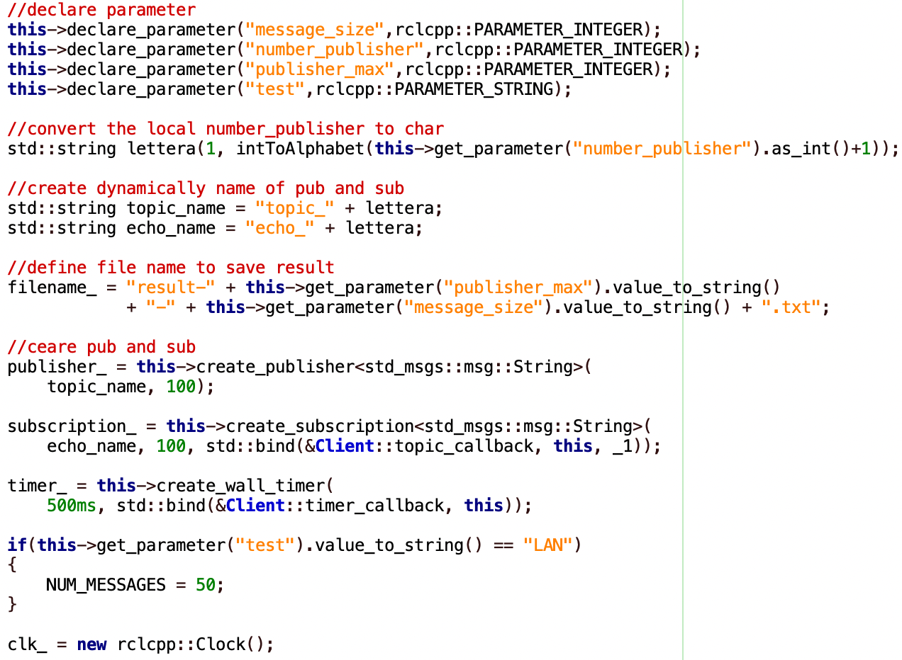
2 – CLIENT STRUCTURE (1)
Define 3 parameter:
message_size → how many byte we want send.
Number_publisher → number of a node.
Publisher_max → total number of node that will be start.
We define 2 function:
timer_callback
topic_callback

Slide 4
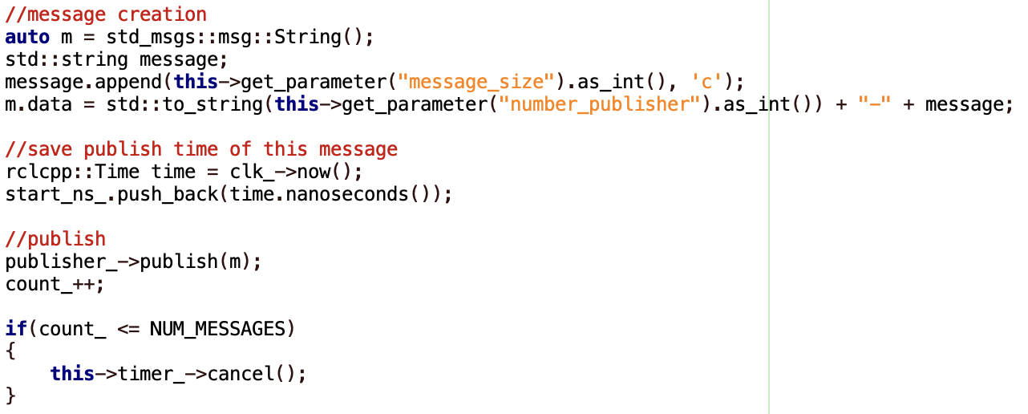
2 – CLIENT STRUCTURE (2)
Timer callback:
Called every define amount of time, to execute a specific set of istruction.
Create message.
Get send time.
Publish

Slide 5
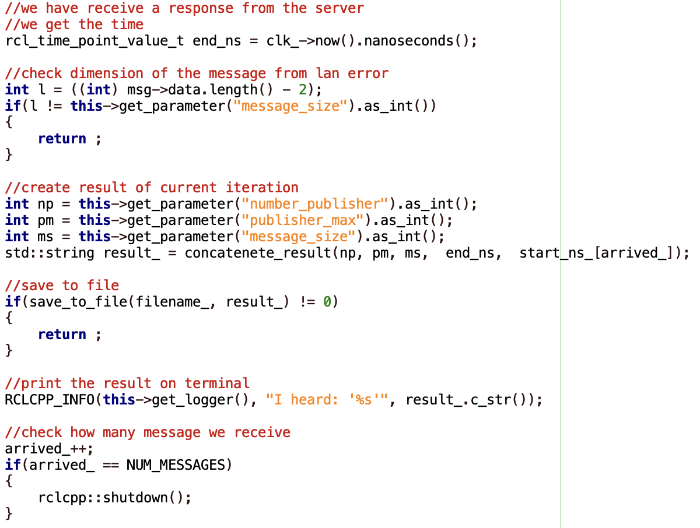
2 – CLIENT STRUCTURE (3)
Topic Callback:
Called every time we receive the response from the server, and perform the following istruction:
Get arrived time.
Check message size.
Structure result
Save result to file and print to terminal

Slide 6
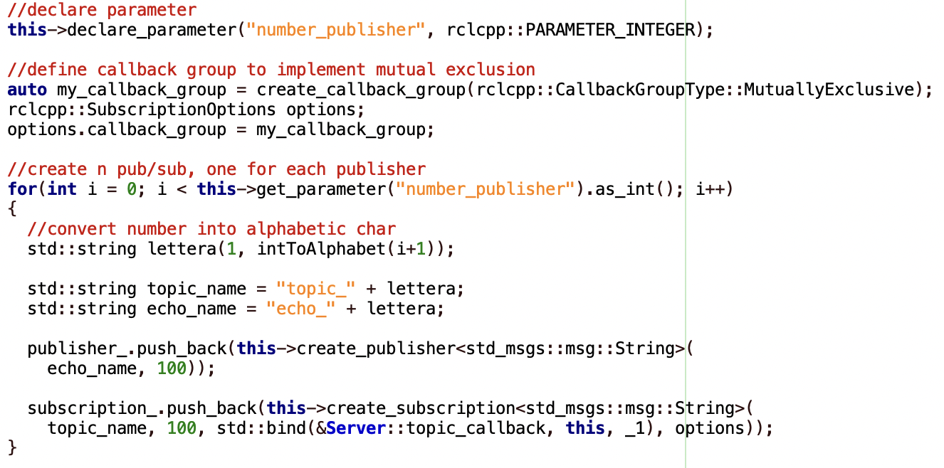
3 – SERVER STRUCTURE(1)
We use a parameter called number_publisher.
And define two vector:
One with n publisher
One with n subscription
For all subscription we use the same function called “topic_callback”

Slide 7
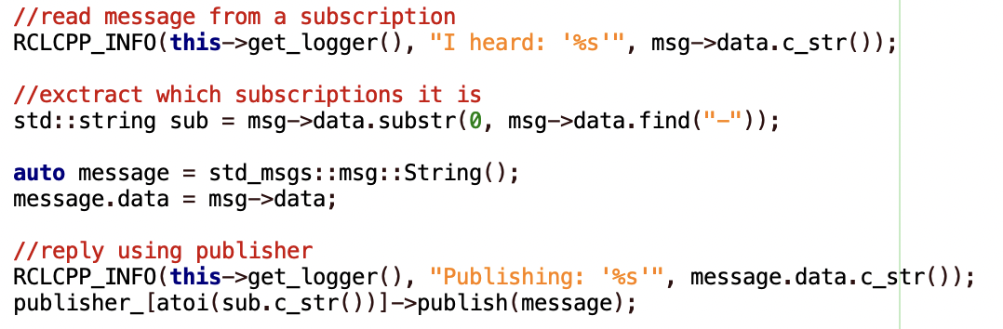
3 – SERVER STRUCTURE(2)
Topic Callback:
Called every time the server receive a new message from one of his client, and perform this instruction:
Print message.
Get which client sent
Replay to that client

Slide 8
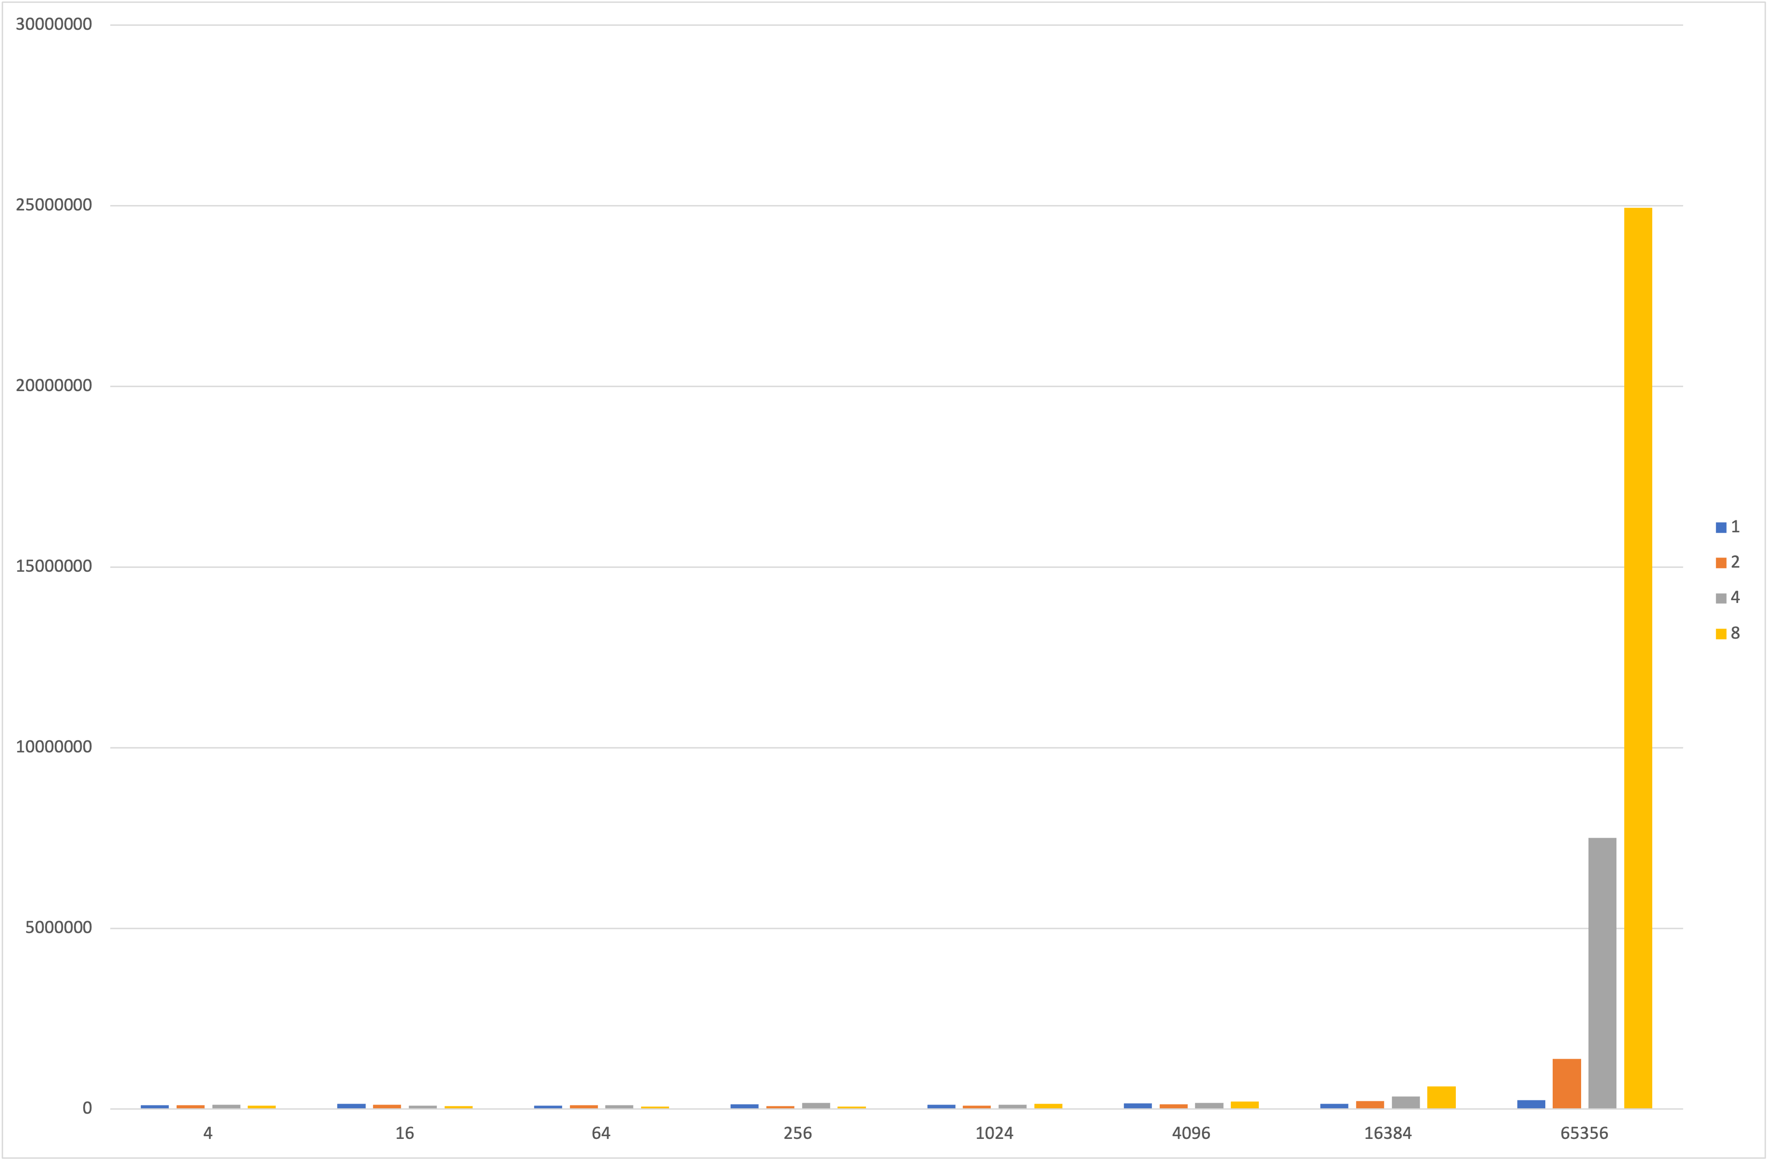
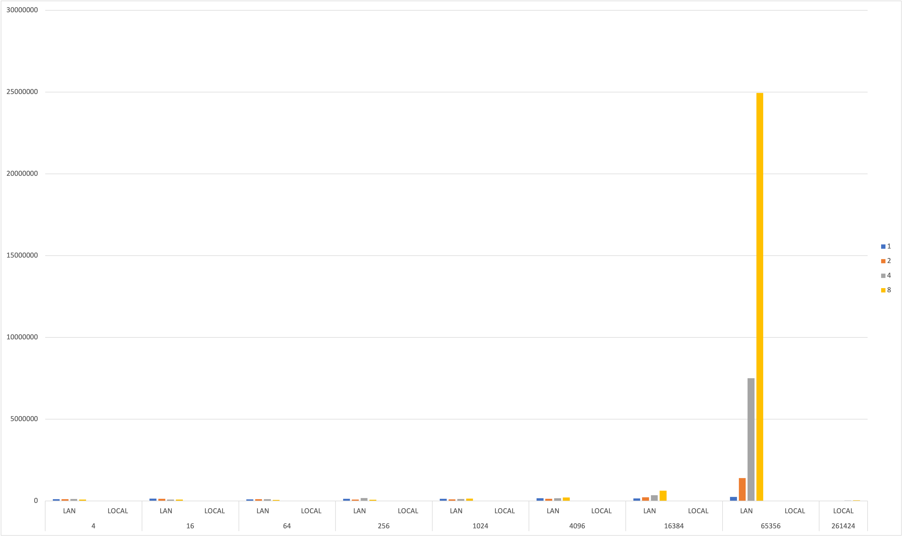
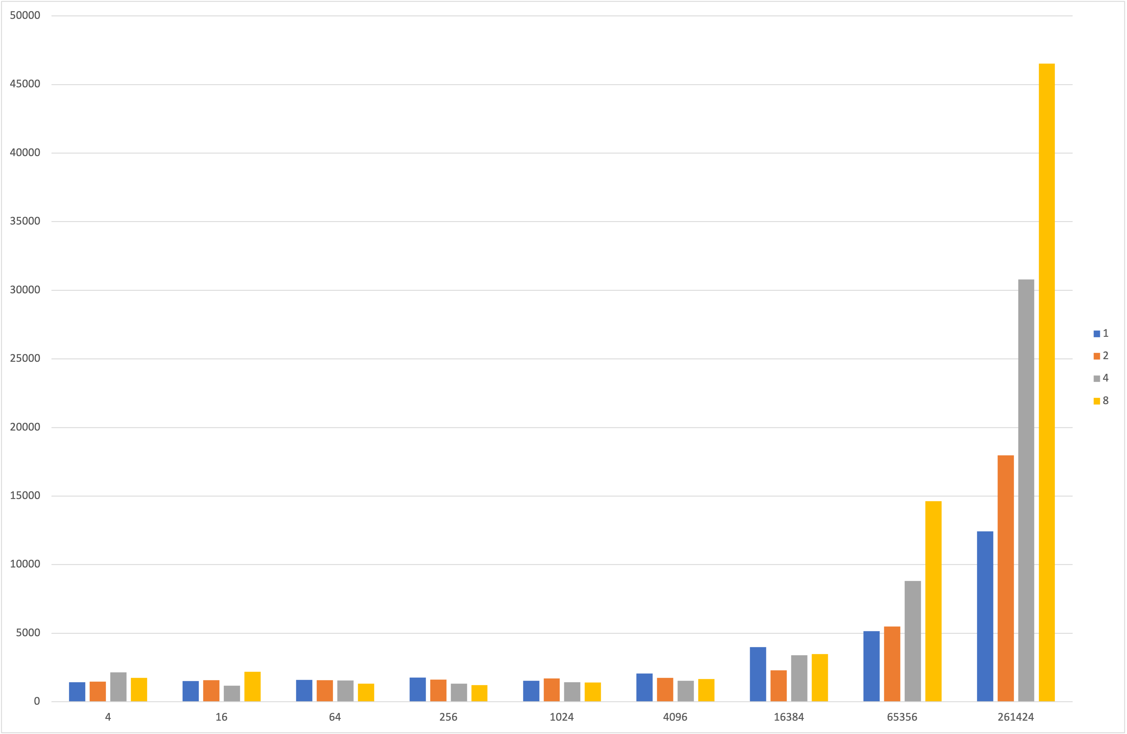
4 – Result (average)
LAN
LOCAL

Slide 9
4 – Result (Writer-LOCAL)

Slide 10
4 – Result (Writer-LAN)

Slide 11
4 – Result (Message size-LoCAL)

Slide 12
4 – Result (Message size-LAN)

Slide 13
5 – FUTURE IMPLEMENTATION
Distribute Client node on multiple machine.
Introduce possible loss message or possbile loss data in a message.
Implement a specific protocol to handle mutual exclusion.

